Slide 1
Circuit optimization in neutral atoms
By Embedded Memes: Matteo Bellino, Stefano Carra, Alessandro Corso, Guglielmo Gigante

Slide 2
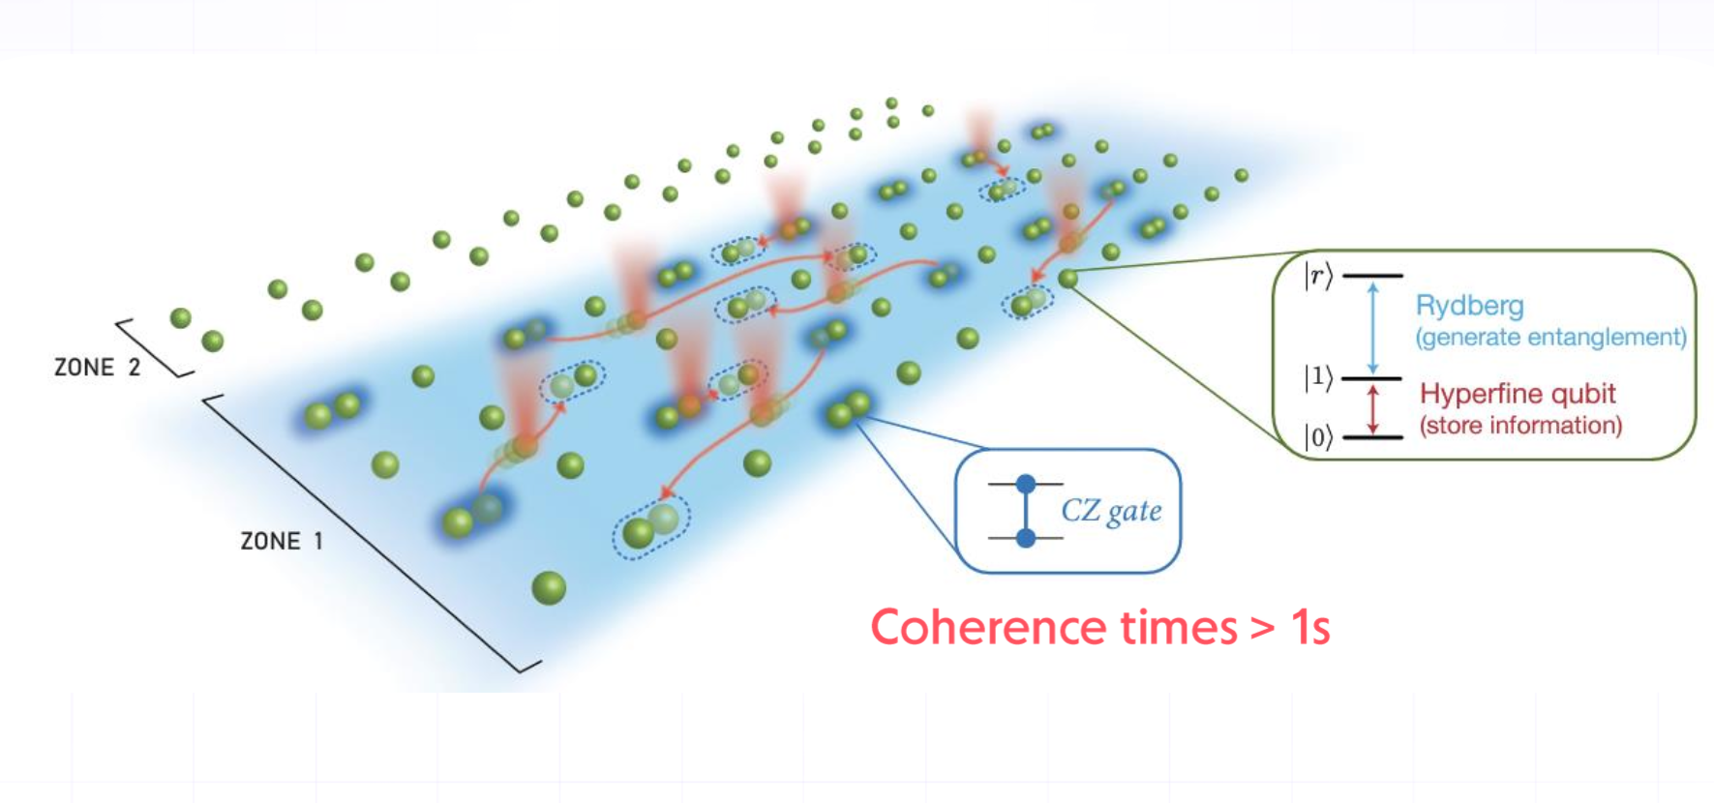
Challenge overview
Advantages of Rydberg atom quantum computing:
Qubit connectivity
High volume parallelization
Universal gate set
Bluvstein et al., Nature (2022)

Slide 3
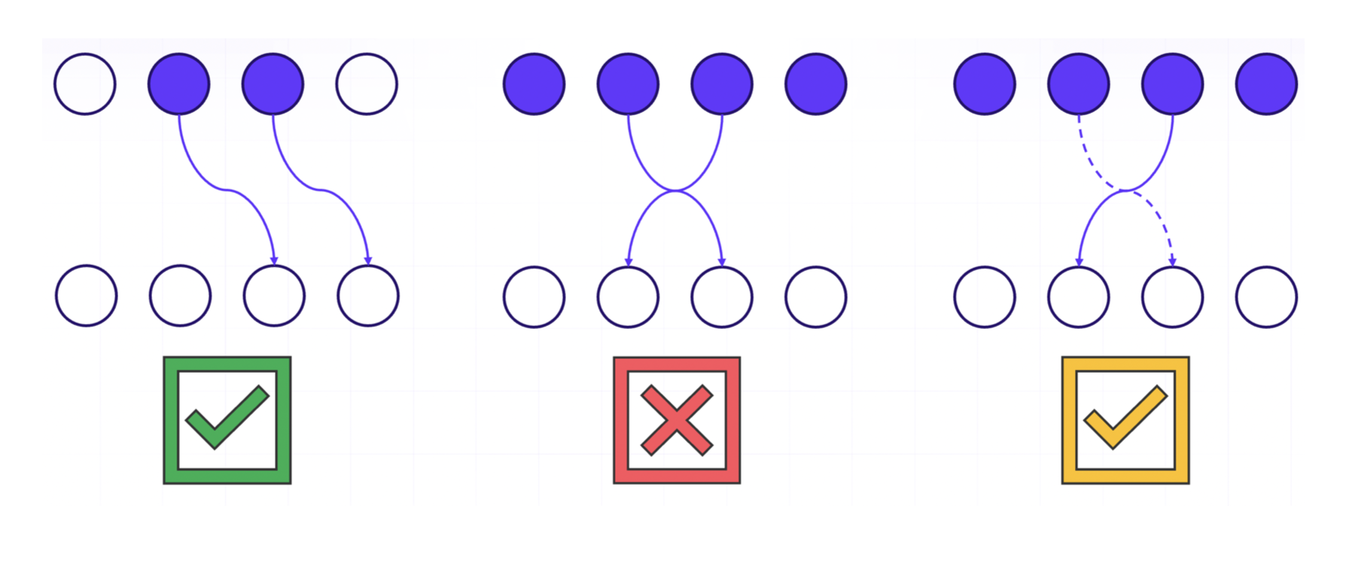
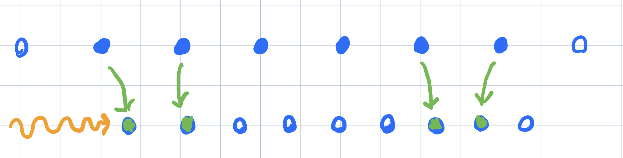
Challenge overview
… and constraints:
Native gate set: U3 and CZ
Register geometry
Shuttling dynamics: no impact on and constraints the simulations
Compatible software:
Bloqade
Qasm2
(Qiskit and others)

Slide 4
Our goals
Implementing optimized versions of challenge circuits with hardware-aware software
Testing their validity
Testing their advantages over non-optimized versions
Beating Casey!

Slide 5
Circuit analysis
Parallel gates counting
Gate counting, gate noise hierarchy: E_CZ > E_L > E_G
No shuttling crossing noise detected in simulations
Circuit depth, by inspection and depth scaling prediction

Slide 6
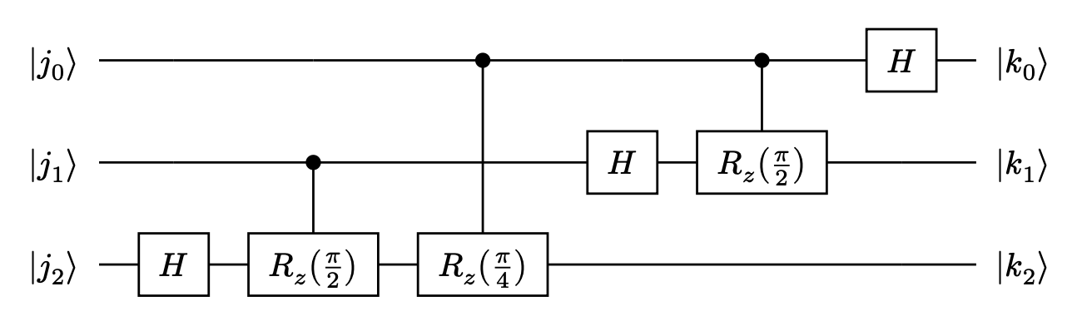
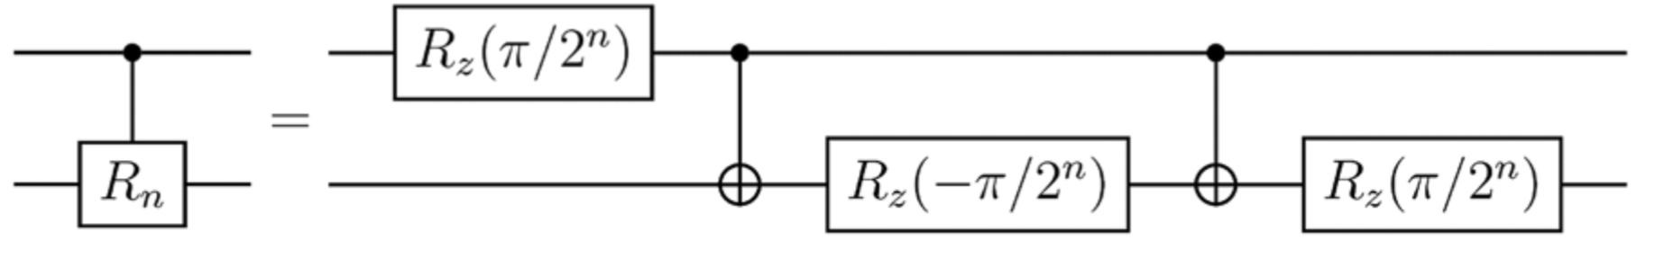
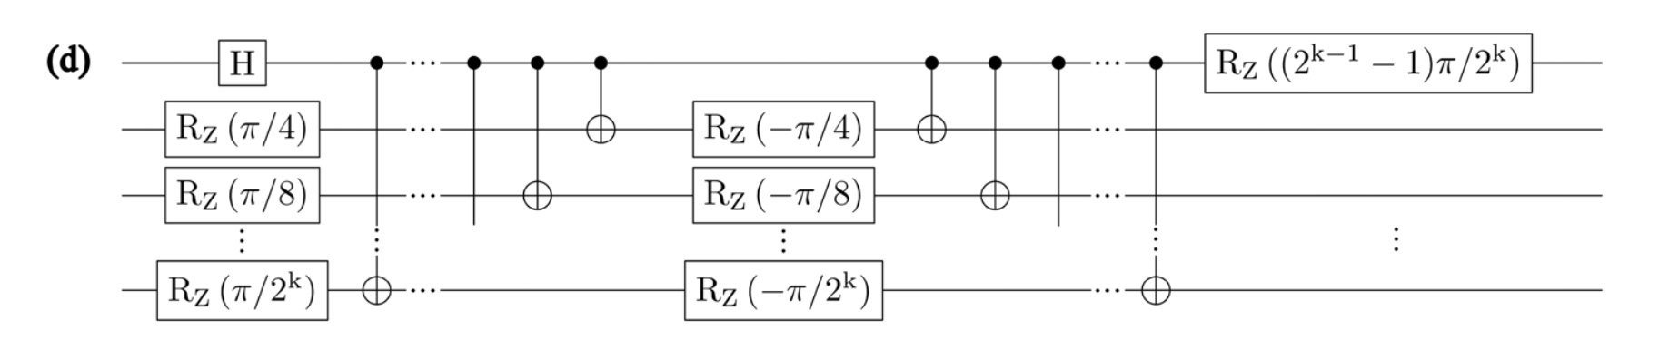
Circuit 1: Quantum Fourier Transform
Park, Ahn, Nature Scientific
Reports 2023

Slide 7
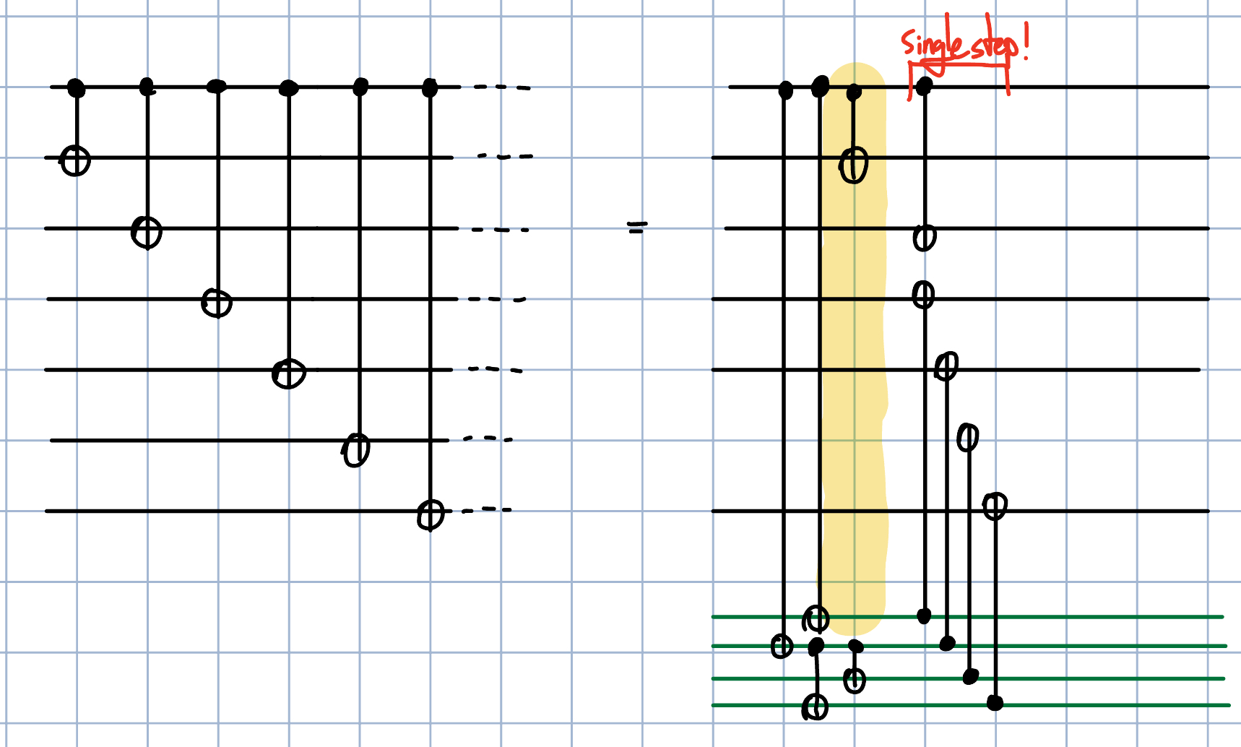
Circuit 1
Log optimization of CNOT ”cascade” for general inputs (not like GHZ preparation!)
Cost: many ancillas!

Slide 8
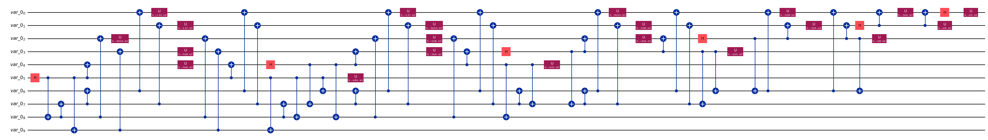
Circuit 1
N=6: total CZ = 30, parallel CZ = 0 -> total CZ = 62, parallel CZ = 22
N=12: total CZ = 161, parallel CZ = 38 -> total CZ = 163, parallel CZ = 58
-> Significant advantage for higher N
Case-by-case output validation with Qiskit succesful!

Slide 9
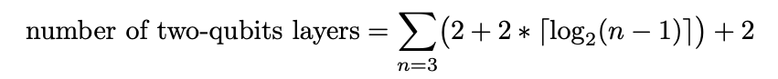
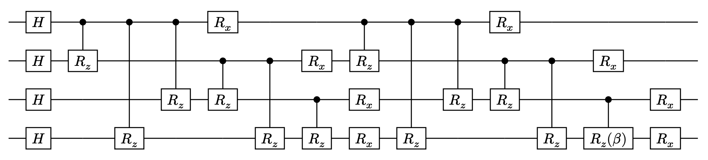
Circuit 2: QAOA
Same strategy as QFT: optimisation of CNOT “cascades”
Depth scaling:

Slide 10
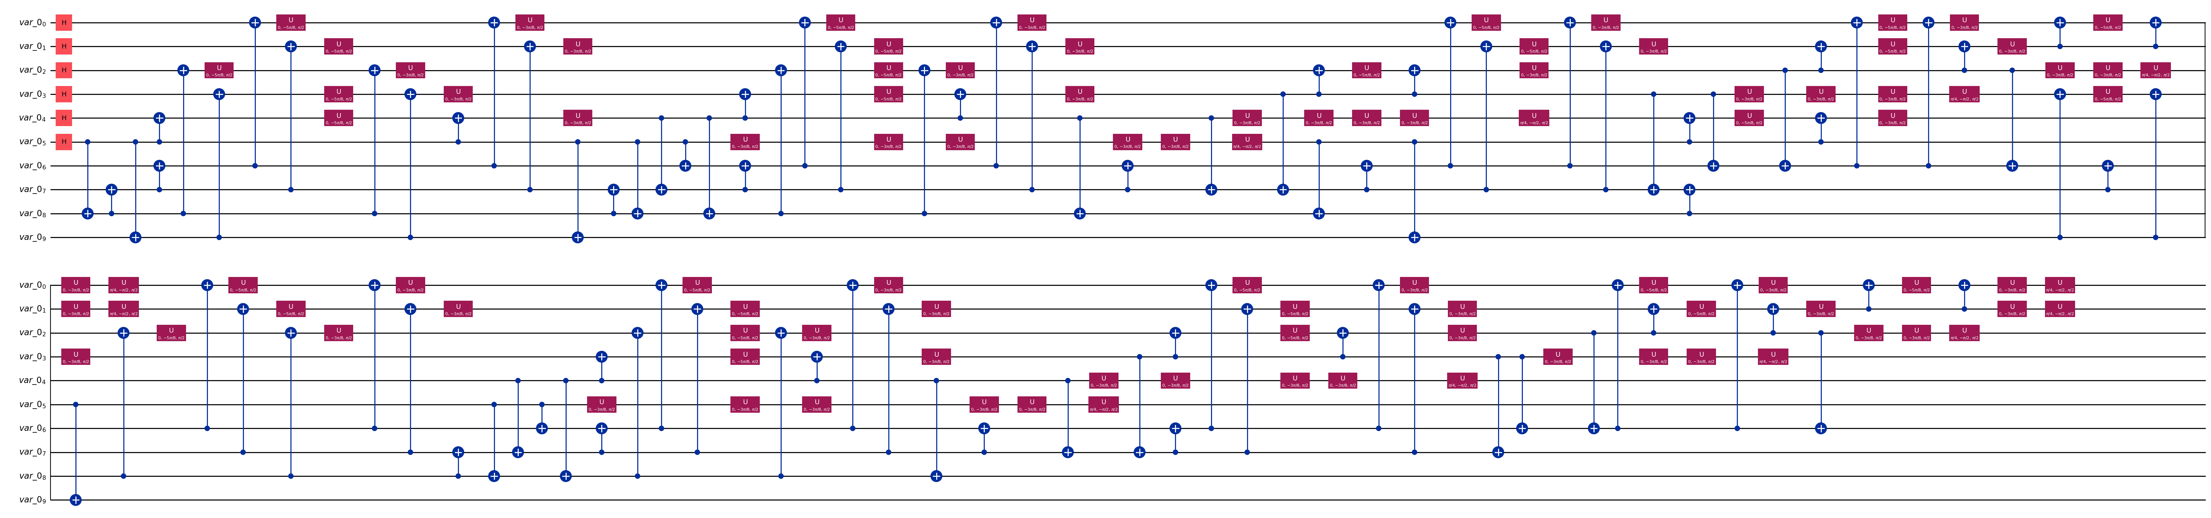
Circuit 2: QAOA
Case-by-case output validation with Qiskit successful!
N=6: total CZ = 60, parallel CZ = 0 -> total CZ = 91, parallel CZ = 9
N=10: total CZ = 180, parallel CZ = 0 -> total CZ = 239, parallel CZ = 71

Slide 11
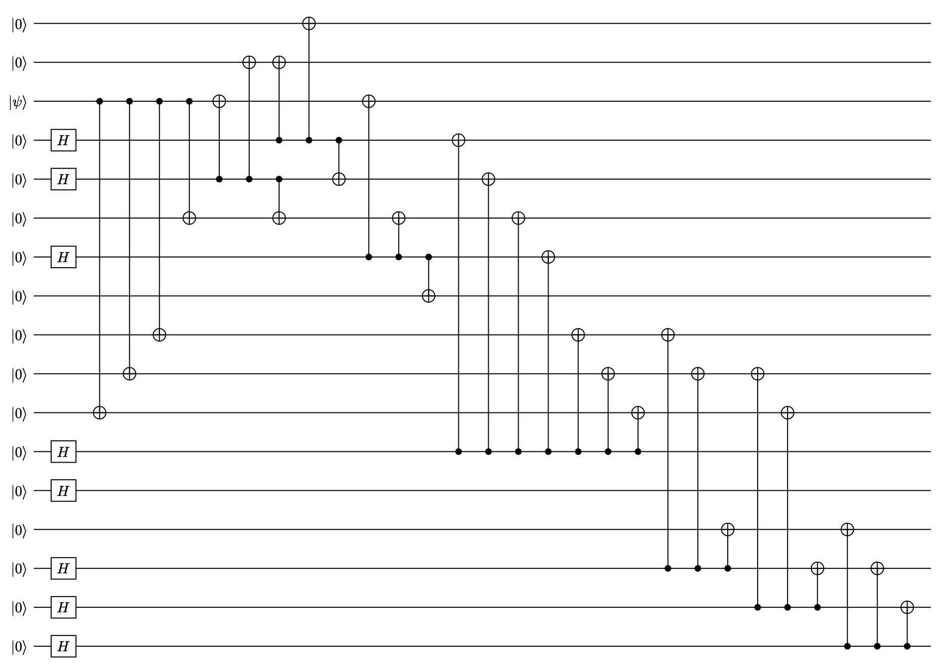
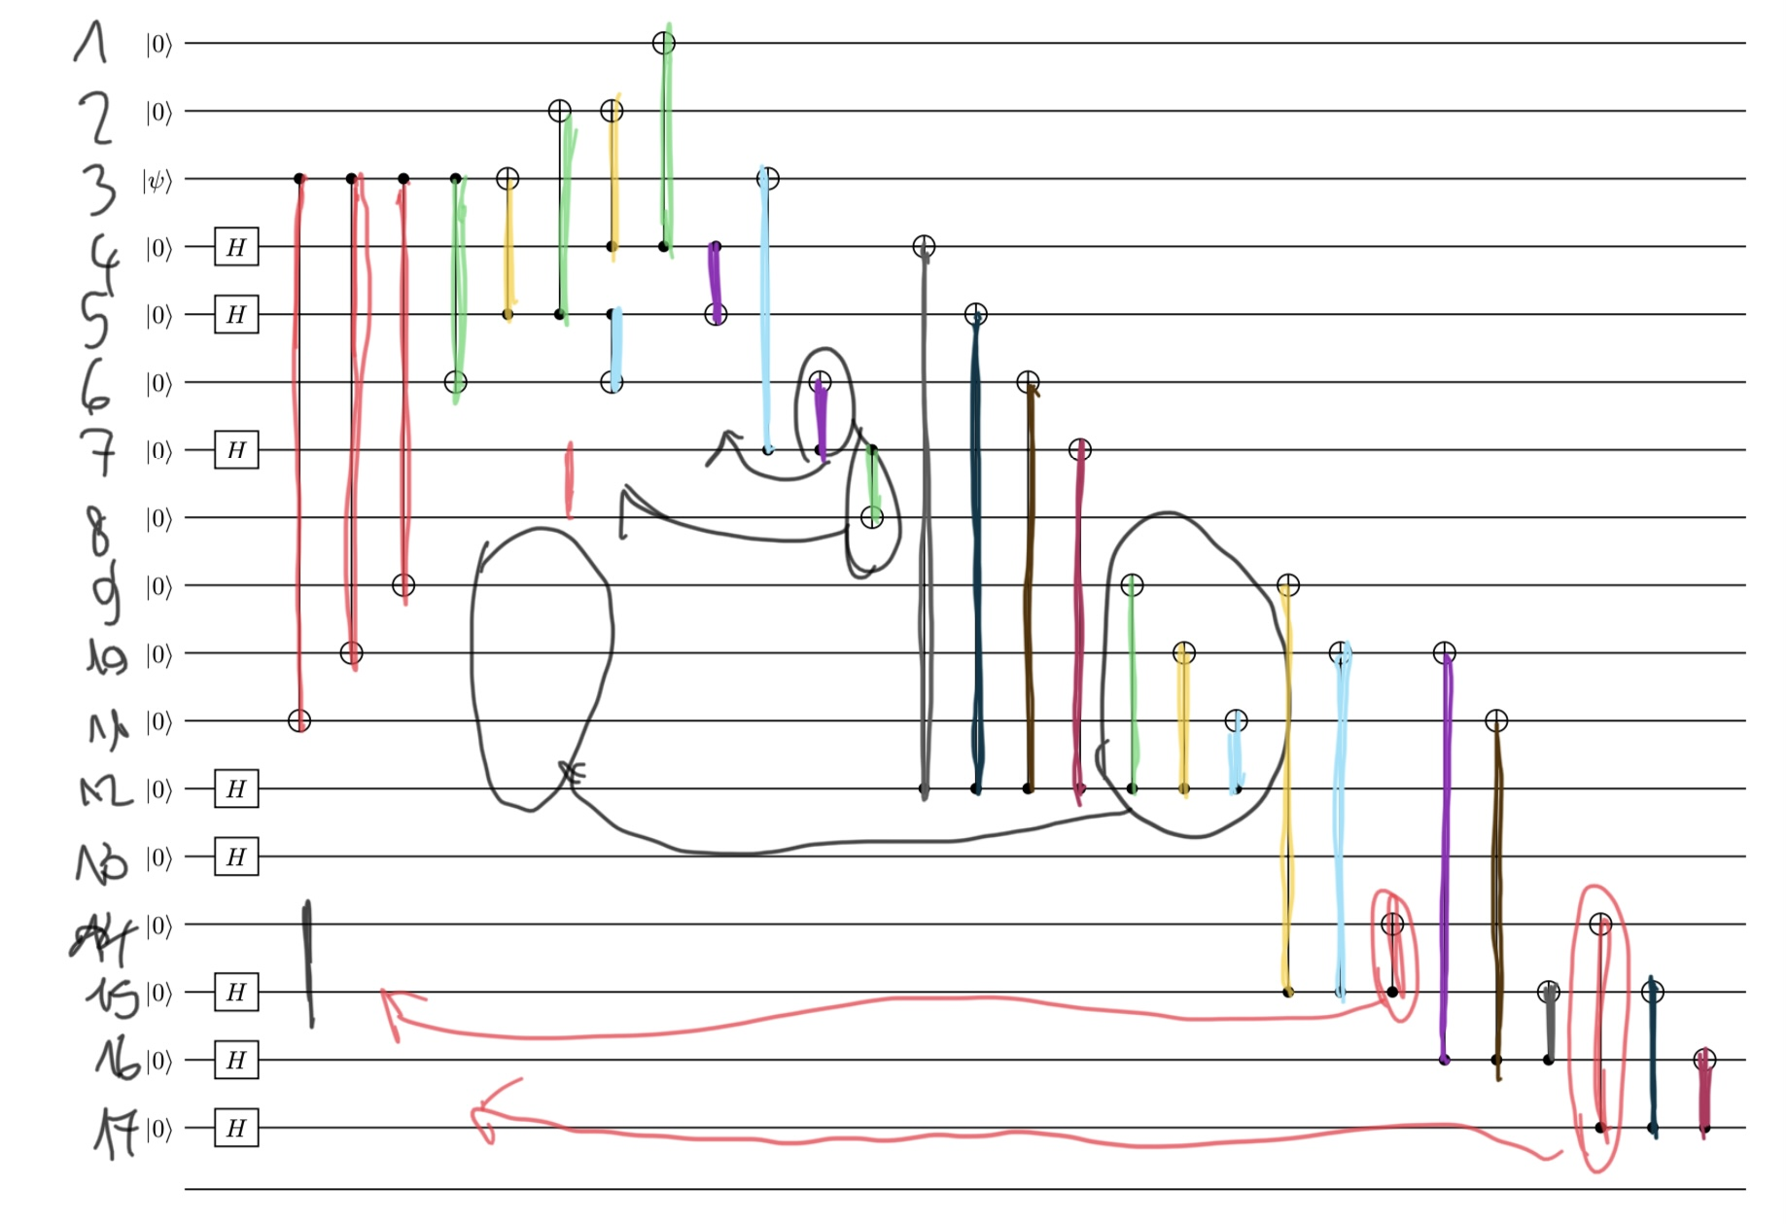
Circuit 3: Distance-5 Surface Code
Full circuit inspection parallelisation

Slide 12
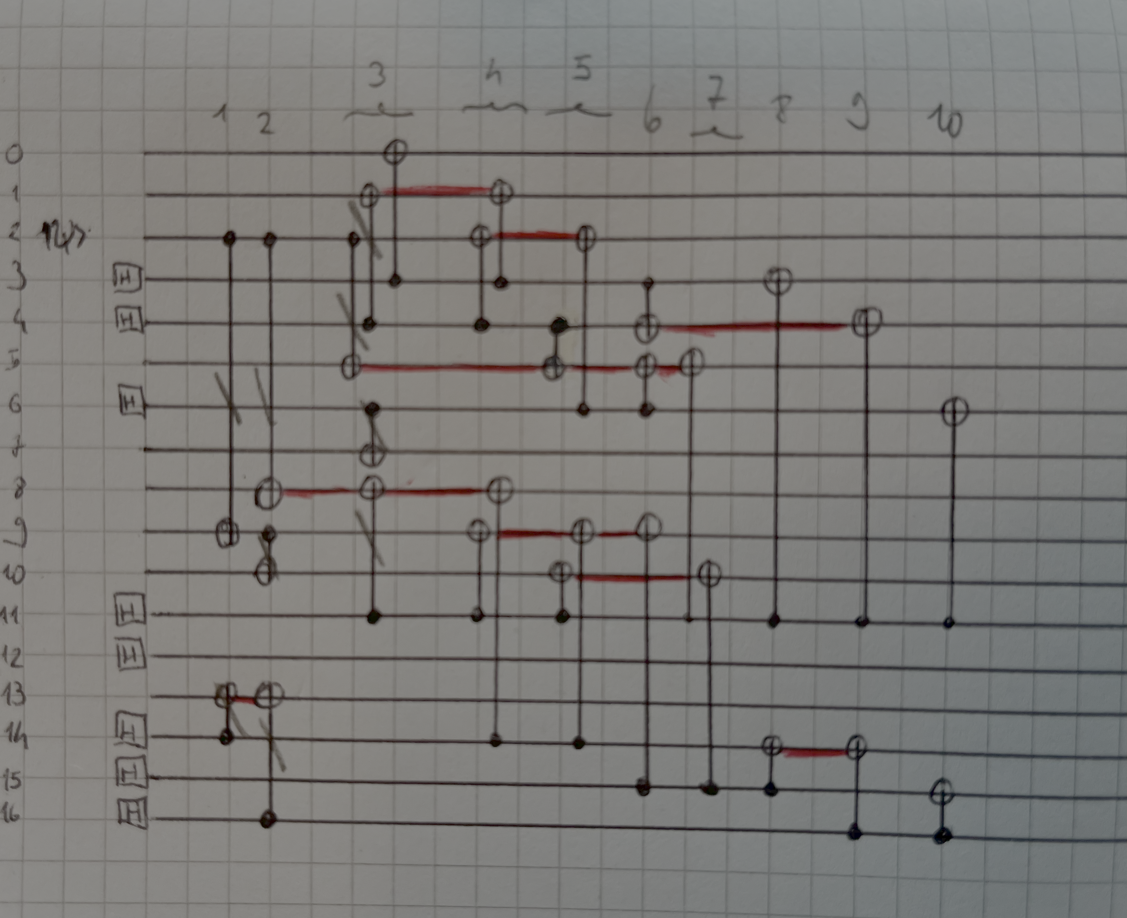
Circuit 3: Distance-5 Surface Code
From 23 to 10 layers!
Validation failed: some mistake somewhere…

Slide 13
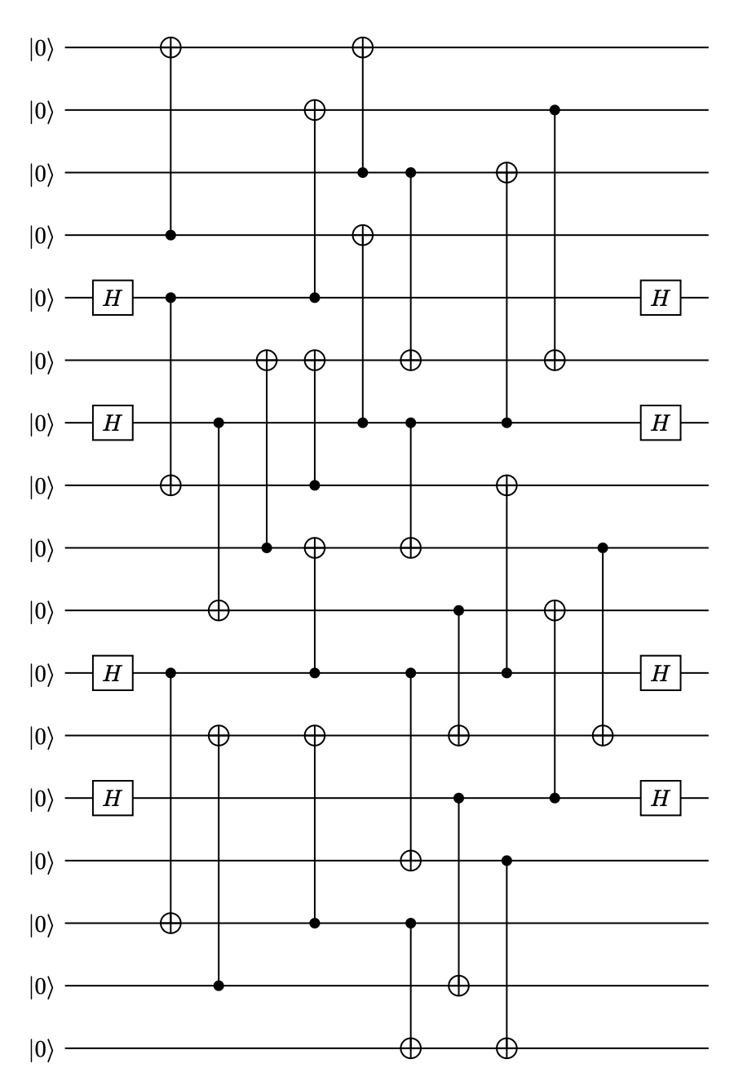
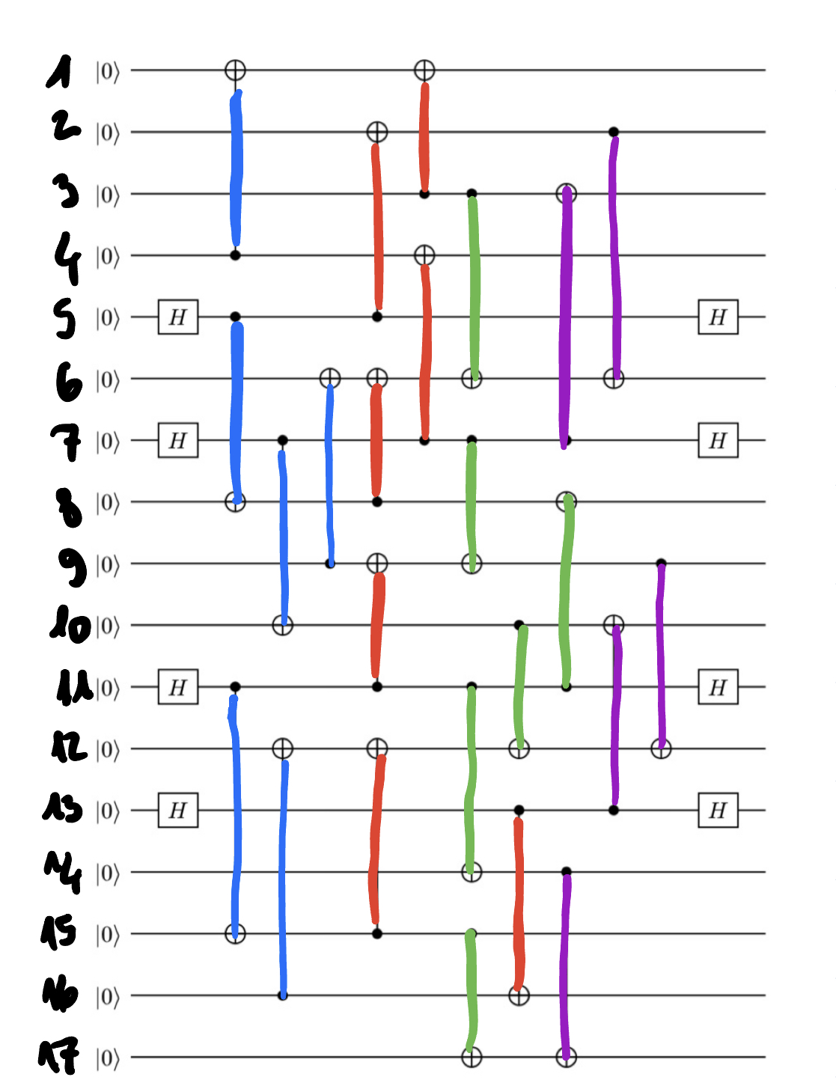
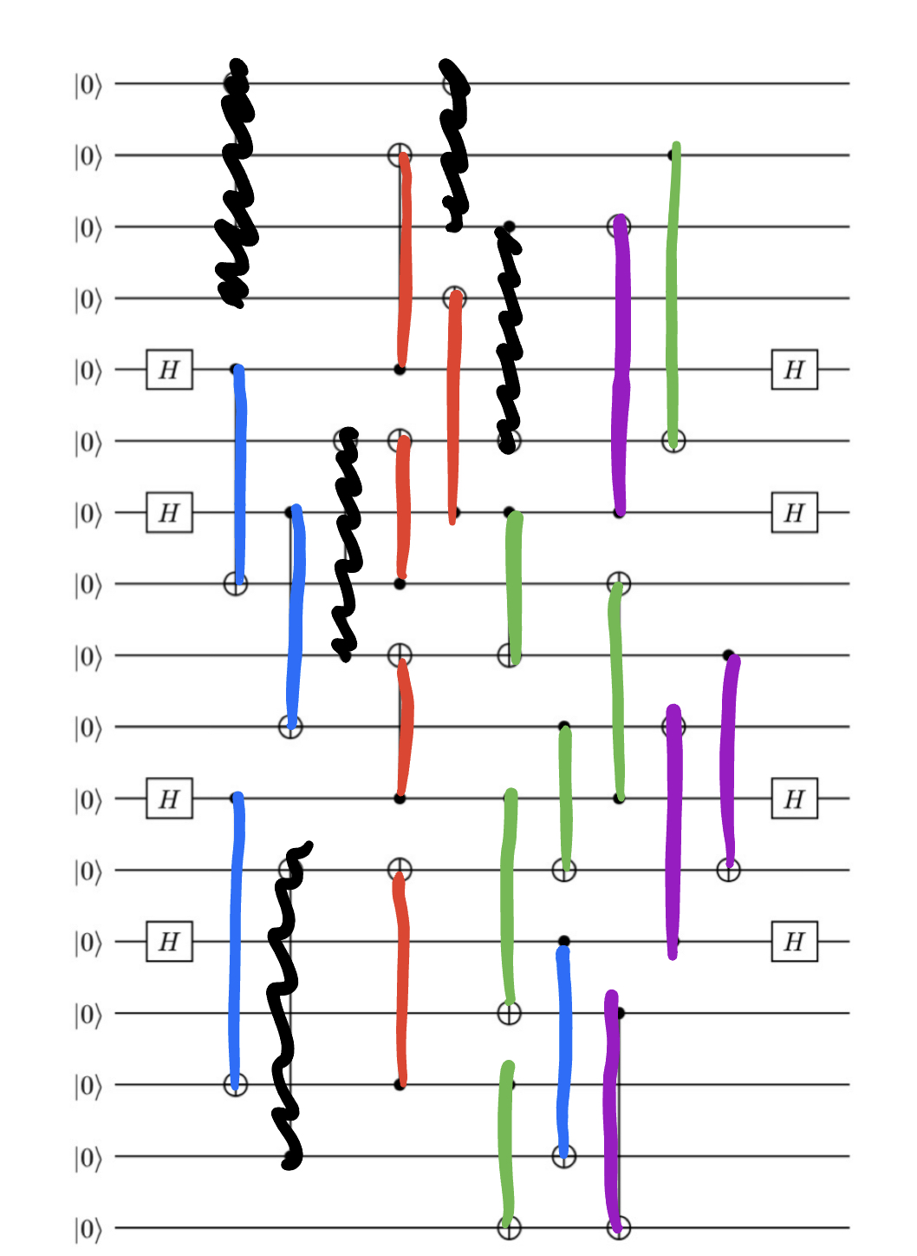
Circuit 4: Distance-3 Color Code

Slide 14
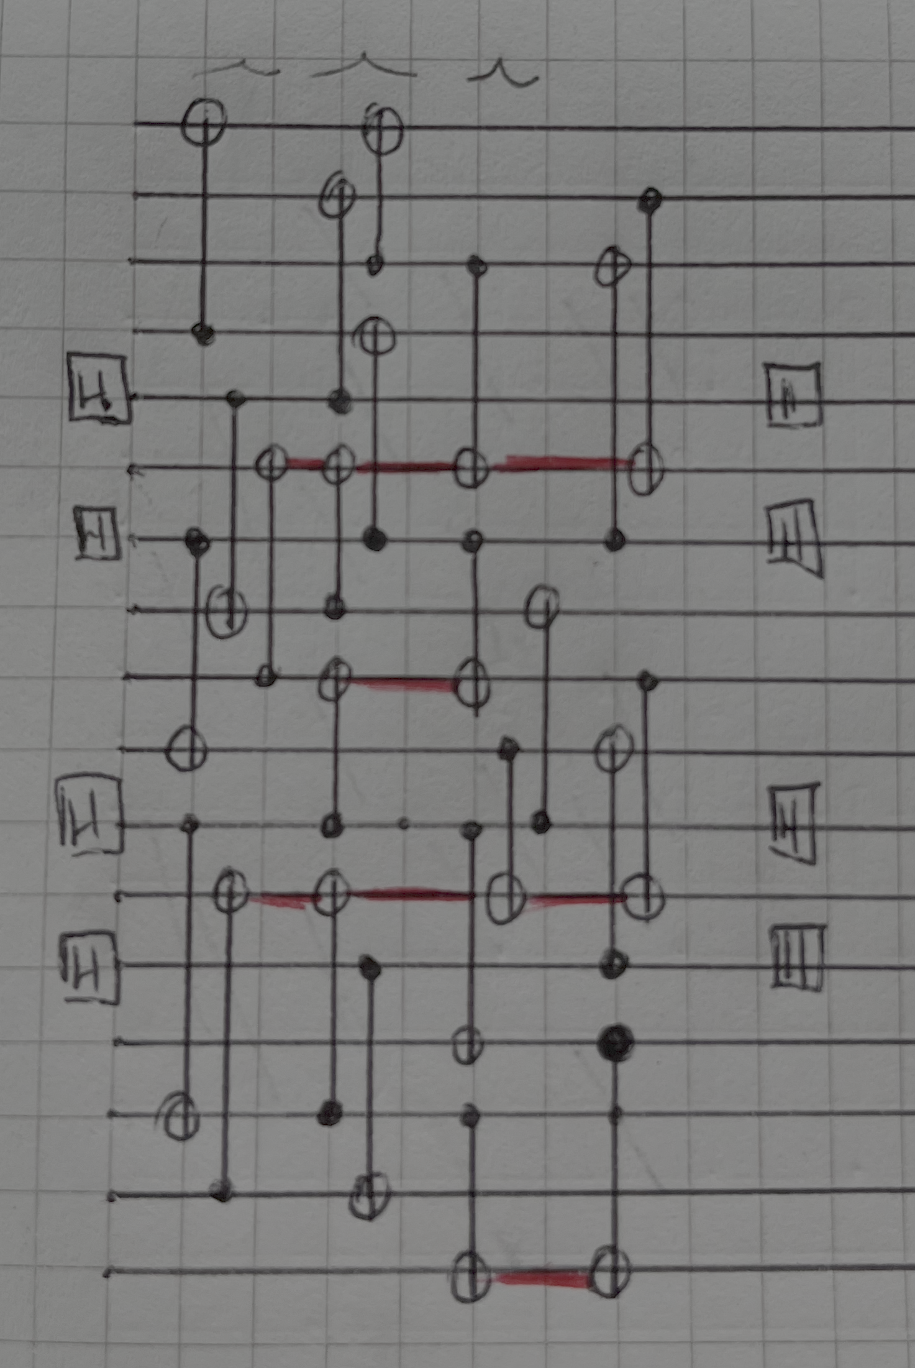
Circuit 4: Distance-3 Color Code
Case-by-case output validation with Qiskit succesful!

Slide 15
Conclusions
Extensively used Bloqade, QASM, together with Python scripts and Qiskit
Challenge tasks were satisfyingly tackled
Tackled several coding challenges with Bloqade for noise simulation
Ready to challenge Casey! See you in the lab ;)

